Slide 1


Instructor Resources
Chapter 11 Figures
Cover photo: BeautyStock – stock.adobe.com.

Slide 2
Chapter 11
Weight and Balance

Slide 3
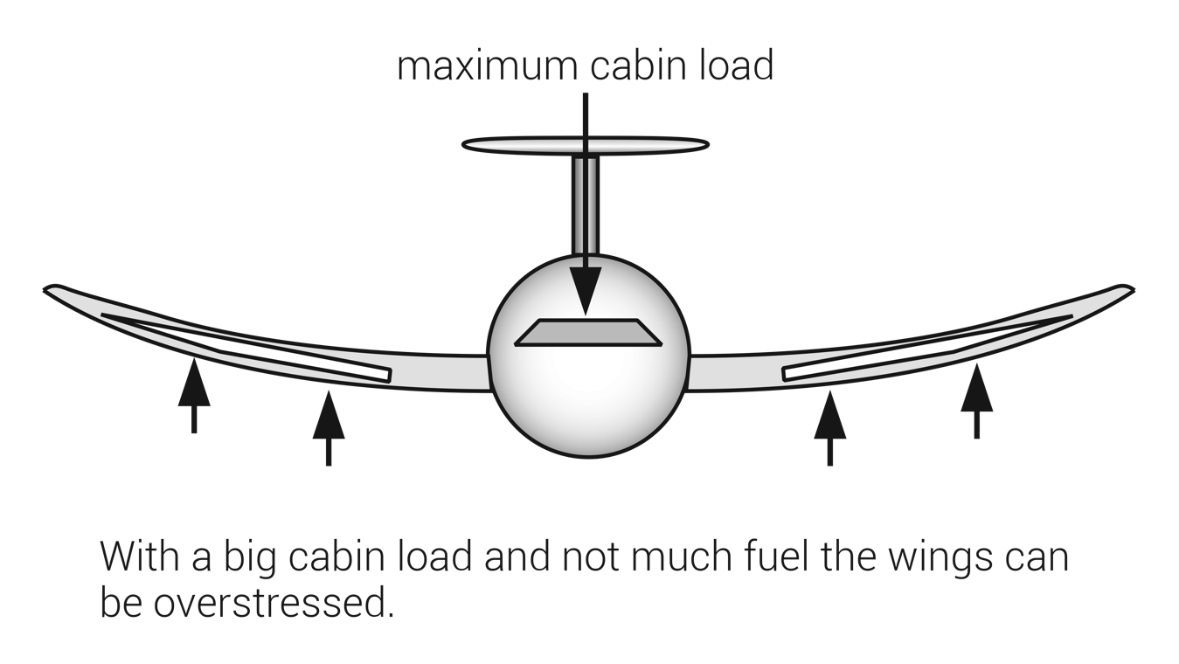
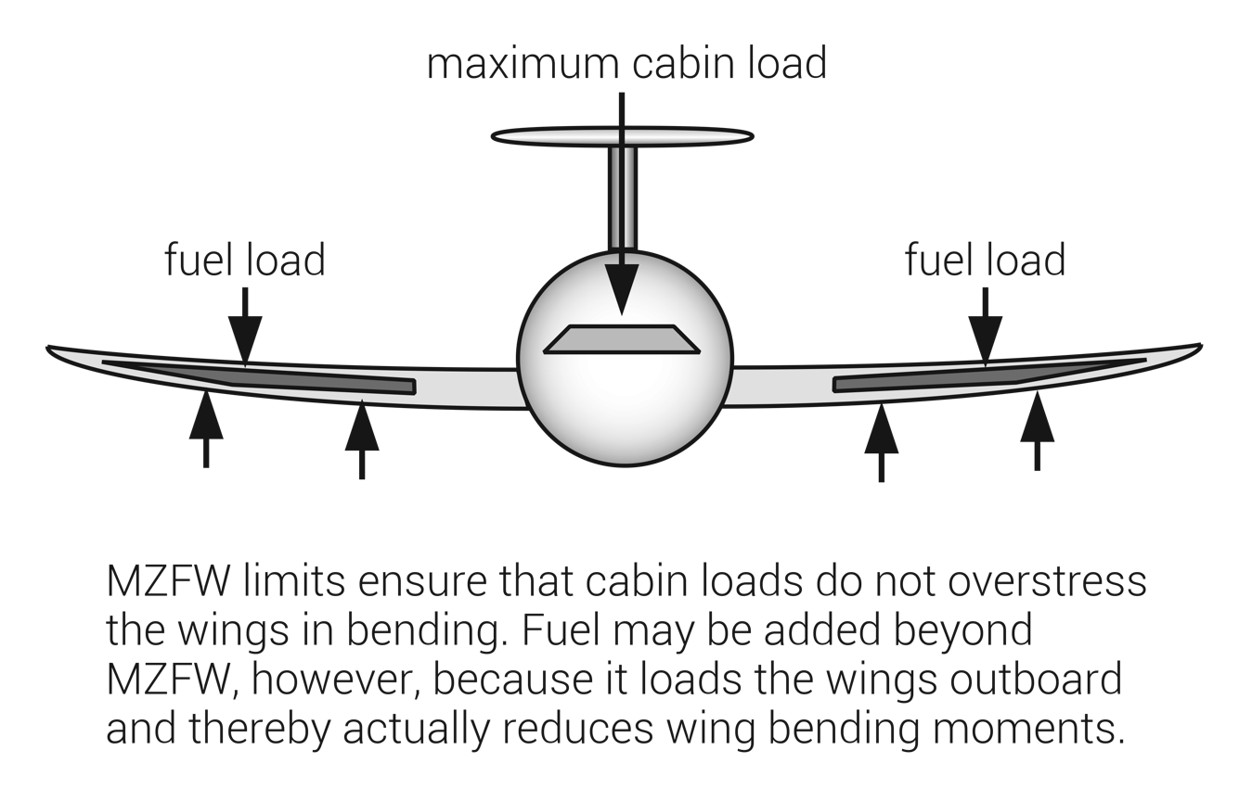
FIGURE 11.1
Maximum zero fuel weight (MZFW).

Slide 4
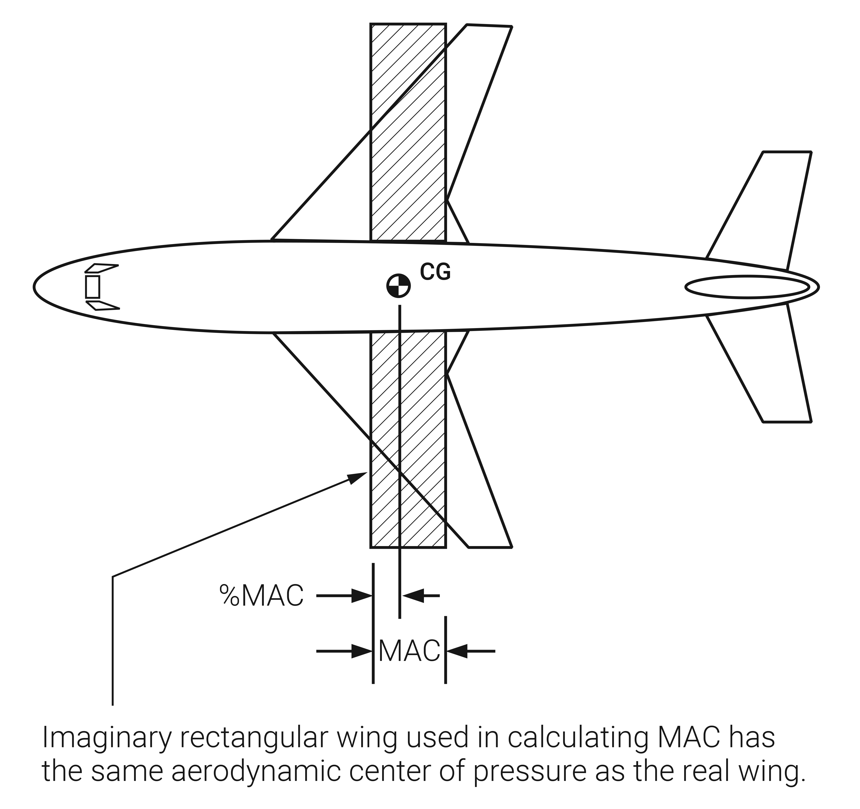
FIGURE 11.2
Mean aerodynamic chord (MAC).

Slide 5
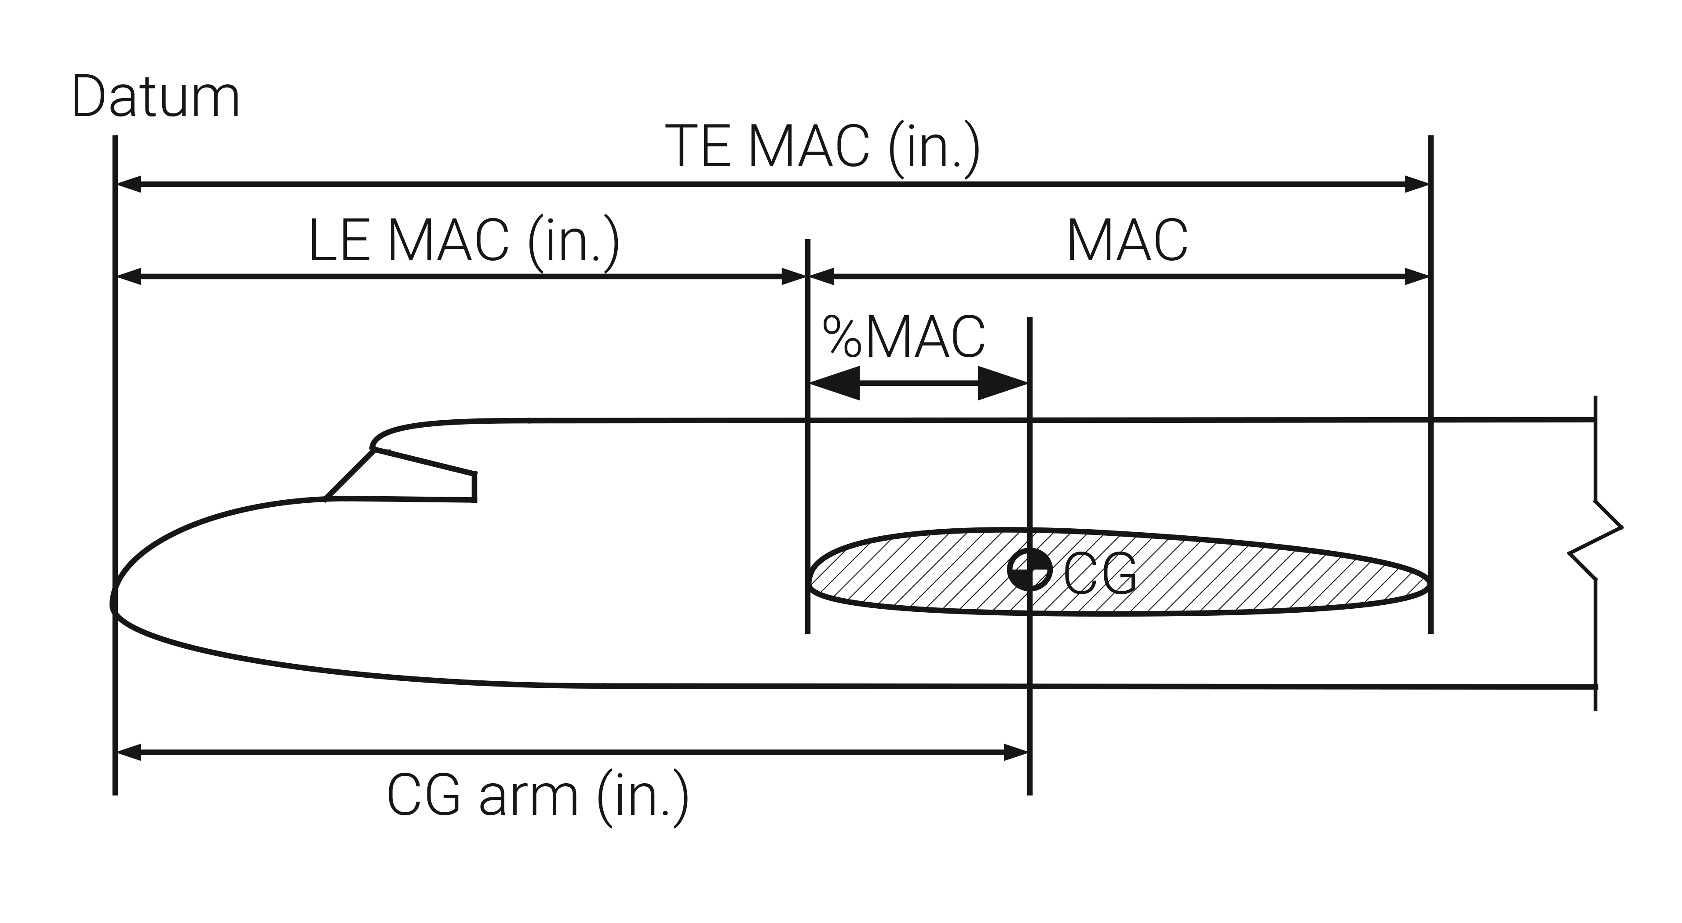
FIGURE 11.3
Center of gravity (CG) as a percentage of mean aerodynamic chord (%MAC).

Slide 6
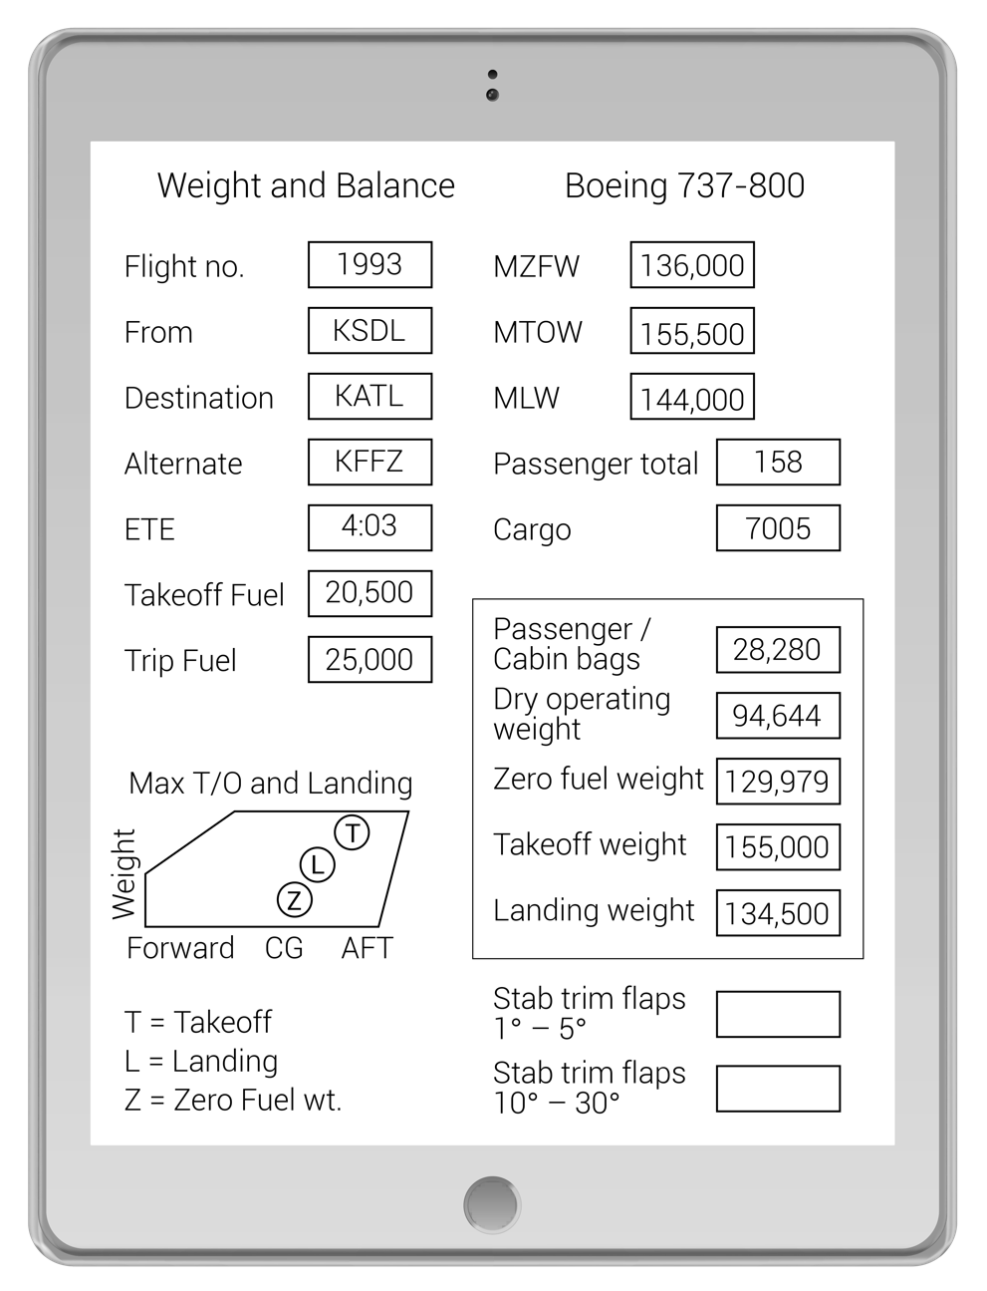
FIGURE 11.4
Weight and balance on an electronic device.

Slide 7
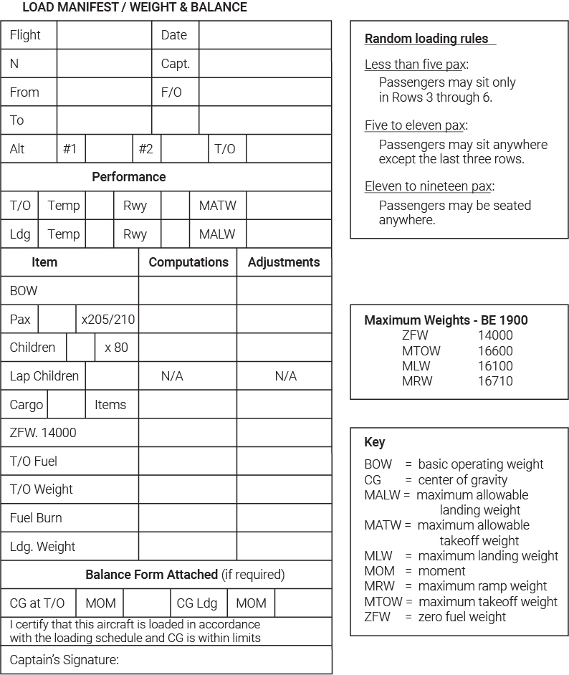
FIGURE 11.5
Typical regional aircraft load manifest and random loading rules.

